Slide 1


Project Work Phase-2(18CSP77) Review On Unusual Crowd Activity Detection and Localization using OpenCV by
GOPALAN COLLEGE OF ENGINEERING AND MANAGEMENT BANGALORE-560 048 Department of Computer Science and Engineering
Project Team Under the Guidance of
Jaikumar K(1GD19CS014) Mrs.Shushma
Karthik S(1GD19CS018) Assistant Professor
Mukesh R(1GD19CS023) Department of CSE,
N Krishna Vamsi(1GD19CS028) GCEM, Bangalore-048.

Slide 2
TABLE OF CONTENTS
Introduction
Abstract
Objectives
Literature Survey
Existing system
Proposed system
Algorithm
Flowchart
S/W And H/W Requirements
Implementation
Conclusion
References

Slide 3
INTRODUCTION
With the increasing importance of security, a great number of surveillance cameras have been installed in private and public places.
There has been significant interest in a smart surveillance system that can automatically detect unusual or abnormal activities.
Unlike human action or interaction recognition, conventional methods are not applicable to the detection and tracking of human subjects in a crowded scene owing to the presence of occlusions, small objects sizes, and other factors.
For unusual activity detection in a crowded scene, texture information such as a spatio-temporal gradient, mixture of dynamic textures, and spatio-temporal frequency has been considered an efficient means of detection.

Slide 4
ABSTRACT
There are various systems developed on the basics of video frame acquisition where motion or pedestrian detection occur but those systems are not intelligent enough to identify the unusual activities even at real time.
It is required to recognized scamper situation at real time from video surveillance for quick and immediate management before any casualties.
Here system uses OpenCV library for classifying different kind of actions at real time and pixel level presentation for making it easy to understand or identify the actual situation.

Slide 5
OBJECTIVES
Earlier proposed systems are capable to detect the actions especially in single user human activity category using skeleton recognition.
The objective of the system is to recognize unusual human activity from crowd using deep learning LSTM and OpenCV for prior appraisal against crime in public places using camera.
It will help to build or install a system that can work 24x7 for real time surveillance and decrease the crowd based criminal activities and saves us from fatal results

Slide 6
Literature sURVEY
Varsha Shrirang Nanaware. [1] made an overview over different executed framework over activity acknowledgment. Various specialists have chipped away at location procedures of different human pursue and activity acknowledgment in an undeniable time moving video. "location systems of different human pursue and activity acknowledgment in an undeniable time moving video observation".
Zakia Hammal et al. [2] proposed a framework which is Based on Conventional Neural Network that trains for human facial acknowledgment. The CNN based AU location uncovered a comparable change in discoveries concerning newborn child quality between assignments. The exactness rate for acknowledgment right activity or articulation runs between 79 to 93 %
Soumalya Sen et al. [3] proposed a framework which depends on picture parsing procedure. Picture parsing relates various kinds of activities which are performed by human that can be perceived in grouping of casings. Activity arranges as – strolling, running, applauding, running, cycling, surfing, and so forth. It depends on frontal area and foundation connection through which framework improves the closer view item and stores these edges for future correlation..

Slide 7
EXISTING SYSTEM
The Existing framework which is Based on Conventional Neural Network that trains for human facial acknowledgment. Framework can be prepared with various outward appearances and track exercises w.r.t. to sentenced articulations. The CNN based AU location uncovered a comparable change in discoveries concerning new born child quality between assignments.
Disadvantages
CNN approach needs more time for training and classifying.
It requires dataset in huge number.
It has less efficiency and accuracy

Slide 8
PROPOSED SYSTEM
We describe a method for representing motion characteristics for the detection and localization of unusual activities within a crowded scene. Here, we should note that, we considered two types of unusual activities: local and global. The activities such as the unique appearance of non-human objects or the fast movement of a person when most of the other pedestrians are walking slowly considered as local. Global unusual activities occur across the frame, for example, when every pedestrian within a scene starts to run suddenly to escape from the scene.
Proposed work is able to recognize human activity in crowd and analyze whether the action is usual or unusual. System purely debates with crowd based activities that ensure situations. System uses OpenCV library along with python IDE that deals with best precision. System proposes motion influence map that comprises for correct recognition rate. Recognizing unusual activity from crowd is difficult task especially for sensor networks; computer vision is an effective approach that can acquire real time human activities and later analyzes for uncommon frames.
Also Enhanced the Work with Improvising the Detection for Violence Using CNN-LSTM Model
Advantages
With the opencv we can easily work in real time and no dataset required for training separately.
The “motion influence map” that efficiently depicts the underlying motion patterns in a crowded scene.
Proposed work is cost-effective for a smart surveillance system to detect both local and global unusual activities in a unified framework.
Provides More Accurate Result.

Slide 9
aLGORITHM
Read sequence of frames in 4d tensor (frame, H, W, RGB)
Apply pre-trained CNN for each frame
Group the result from the previous step and flatten the tensor to be a 2d shape (frames, SP) where SP is (H*W*RGB) and represent a spatial feature vector for one frame.
Use the previous step output as feature vector input to LSTM where SP represent input and Frame represent time step ex for 30 frame input we have (SP1, SP2 .. SP30) each goes in a time step of LSTM.
Take full sequence prediction from LSTM and feed it to a dense layer in a time distributed manner.
Take the global average of the previous step output to get the result as a 1d tensor.
Feed the output of the previous step into the output layer (dense layer with sigmoid activation which represents the probability of violence existence in the given video).

Slide 10
Flow chart

Slide 11
s/w and h/w requirements
HARDWARE REQUIREMENTS
System : Intel IV 2.4 GHz.
Hard Disk : 500 GB.
Ram : 4 GB
SOFTWARE REQUIREMENTS
Operating system : Windows 7 / 8 / 10
Coding Language : Python
Software : Anaconda
IDE : Spyder / Jupyter Notebook /Pycharm

Slide 12

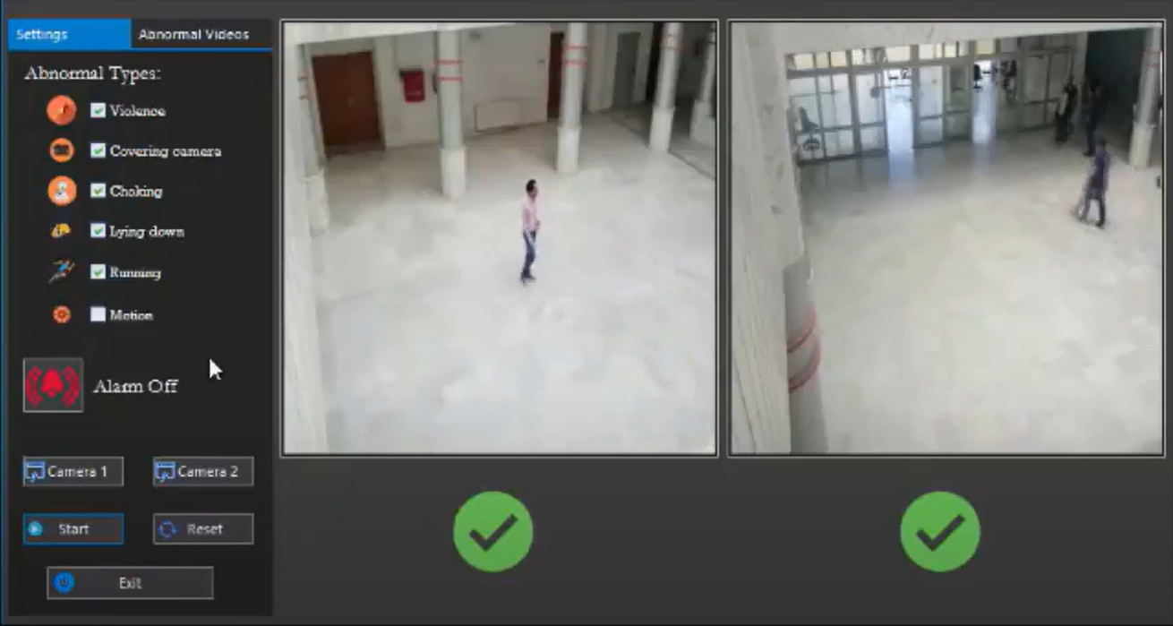
implementation

Slide 13
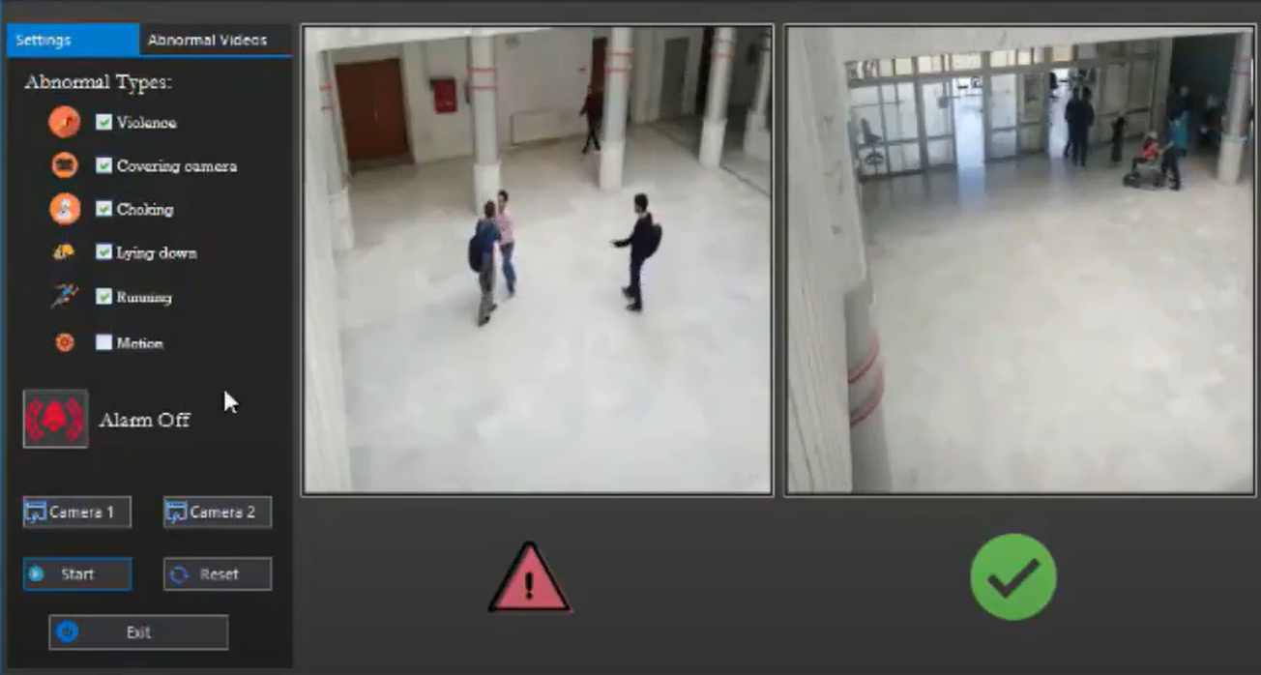
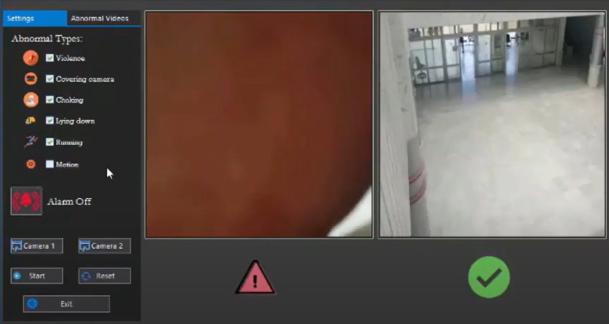
Violence
Covering Camera

Slide 14
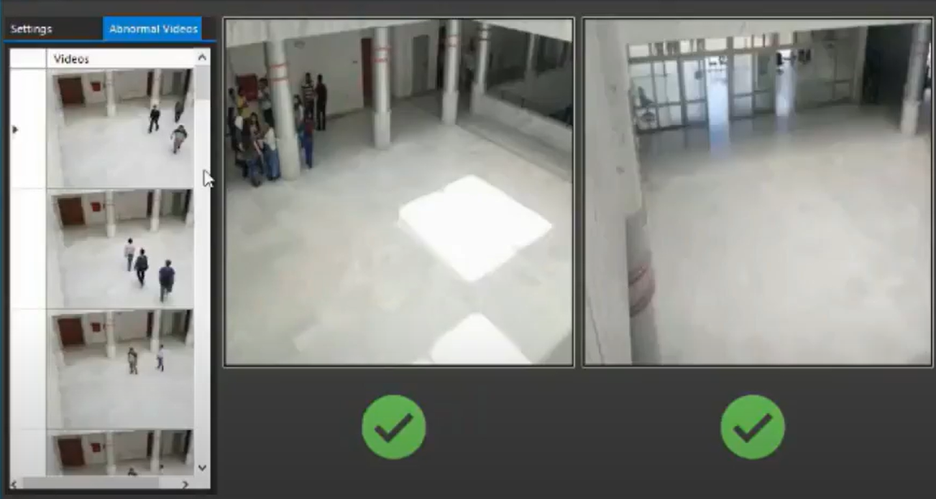
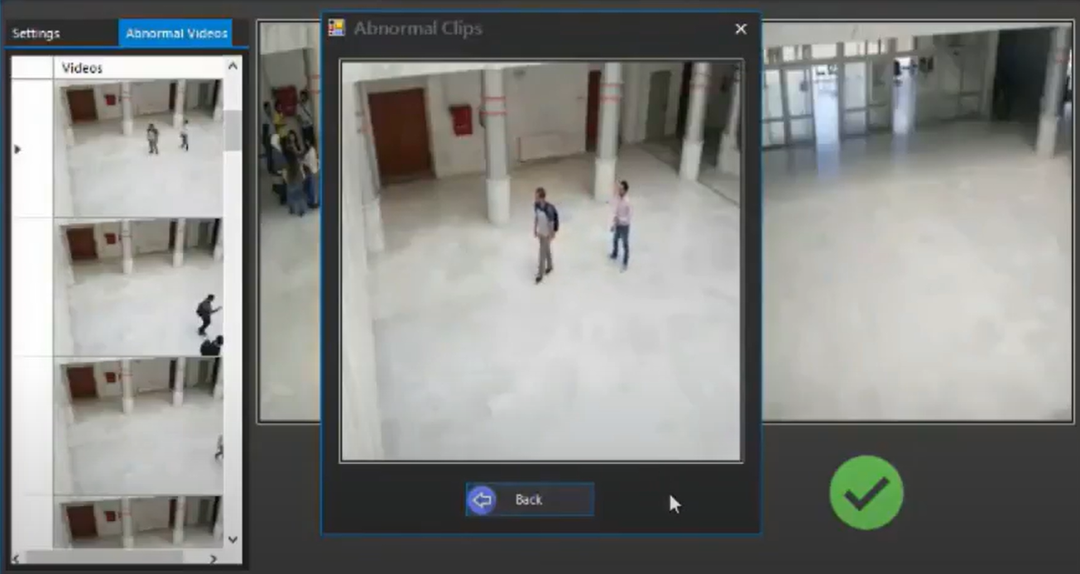

Slide 15
CONCLUSION
The systems which have been proposed till now are intended to recognize simple human action such as walking, running and many more but not suitable for crowded area.
Proposed system is able to work for Prior Appraisal against Crime. The accuracy is 96.42 % which is good enough for recognizing unusual activity in complex backgrounds.
The proposed system is capable enough to efficiently recognize the unusual human activity from crowd by using OpenCV and deep learning LSTM , which enhances the accuracy and proficiency of the system up to a great extent.

Slide 16
REFERENCES
D. Aranki, G. Kurillo, P. Yan, D.M. Liebovitz, and R. Bajcsy, “Continuous, real-time, tele-monitoring of patients with chronic heart-failure: lessons learned from a pilot study,” in International Conference on Body Area Networks (Bodynets), 2014.
Abouzar Ghasemi and C.N. Ravi Kumar, “A Novel Algorithm To Predict And Detect Suspicious Behaviors Of People At Public Areas For Surveillave Cameras” Proceedings of the International Conference on Intelligent Sustainable Systems (ICISS 2017)
Y. Nam, S. Rho, and J. Park, “G3d: A gaming action dataset and real time action recognition evaluation framework,” IEEE Conference on Computer Vision and Pattern Recognition Workshops (CVPRW), 2012.
Y. Nam, S. Rho, and J. Park, “Intelligent video surveillance system: 3-tier context-aware surveillance system with metadata,” Multimedia Tools and Applications, vol. 57, pp. 315–334, 2012.

Slide 17
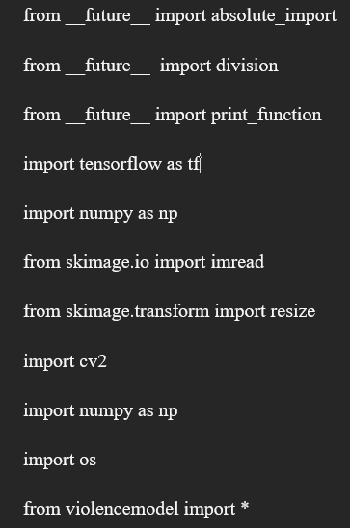
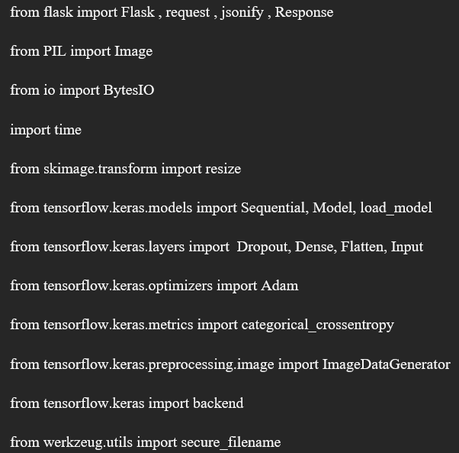
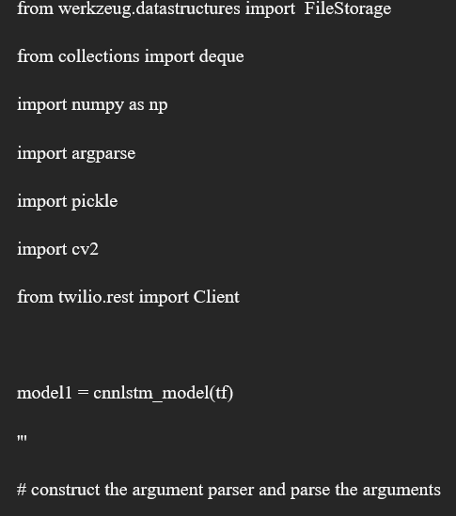
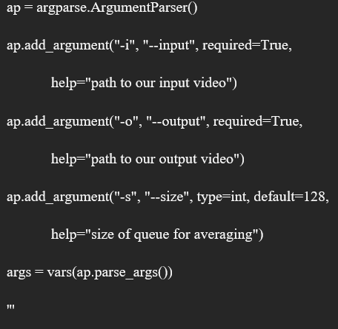
CURRENT STATUS

Slide 18
THANK YOU

